Slide 1






MapTek
Hire-me Coder
Group PG05

Slide 2


CONTENTS
01 Introduction
02 Technology Kits
03 Project Process
04 User Journey
05 Achievement
06 Conclusion

Slide 3
1
Introduction
A general description about the project and Hire-me Coder

Slide 4
Introduction
A general description about the project and Hire-me Coder
The main purpose of this project is to develop a system which can check the candidate coding ability could that can match the Maptek requirement.
This project is a web-based application and obtained both administrator and interviewees.
Candidates have particular time period to complete the online test.
Administrators can have access to verify the candidate answers

Slide 5
2
Technology Kits
Technology used in developing the Hire-me Coder

Slide 6




Technology Kits
Technology used in developing the Hire-me Coder
Development Tools
Frontend: PUG & Bootstrap
Backend: Node.JS
Database: Firebase

Slide 7



Technology Kits
Technology used in developing the Hire-me Coder
Cooperative Tools
Communication: Slack
Cloud & Version control: GitHub
Kanban & To-do list: Trello

Slide 8
3
Project Process
The detailed processes of the whole project

Slide 9
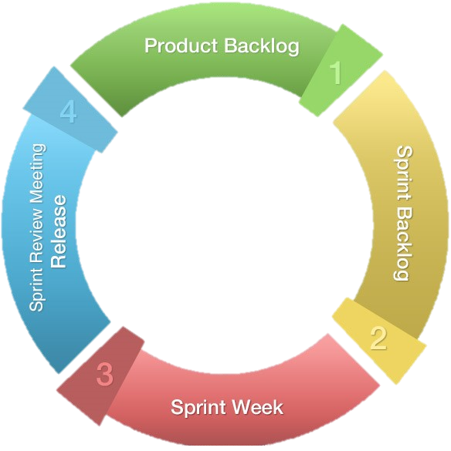
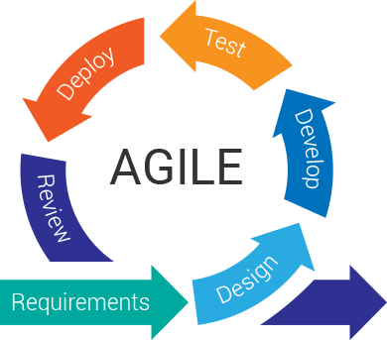
Project Process
The detailed processes of the whole project
Scrum
Methodology
Stand Up meetings with the client
Internal meeting before Sprint
Review meeting after Sprint
Process Model

Slide 10
Project Process
The detailed processes of the whole project
Week 1-3
Week 7-9
Sprint 1
Sprint 3
Sprint 5
Project Conception and Initiation
Milestone 1
Delivery
Week 4-6
Week 10-12
Sprint 2
Sprint 4
Project Definition and Planning
Milestone 2

Slide 11
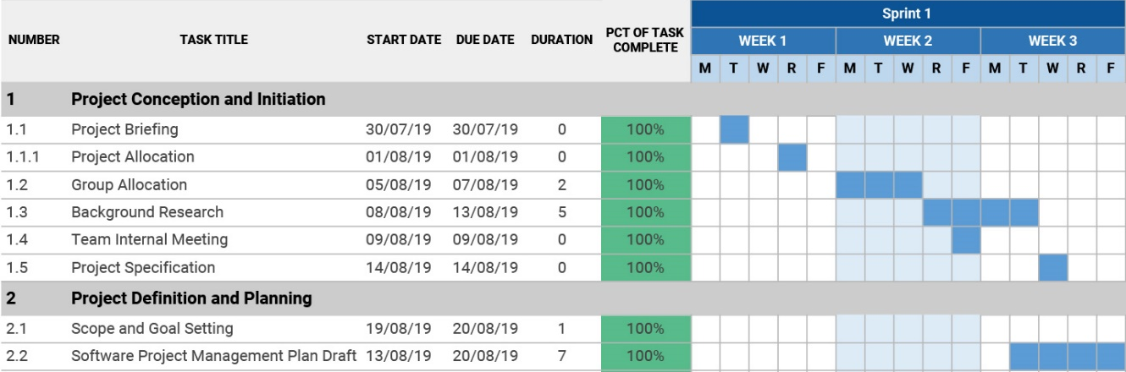
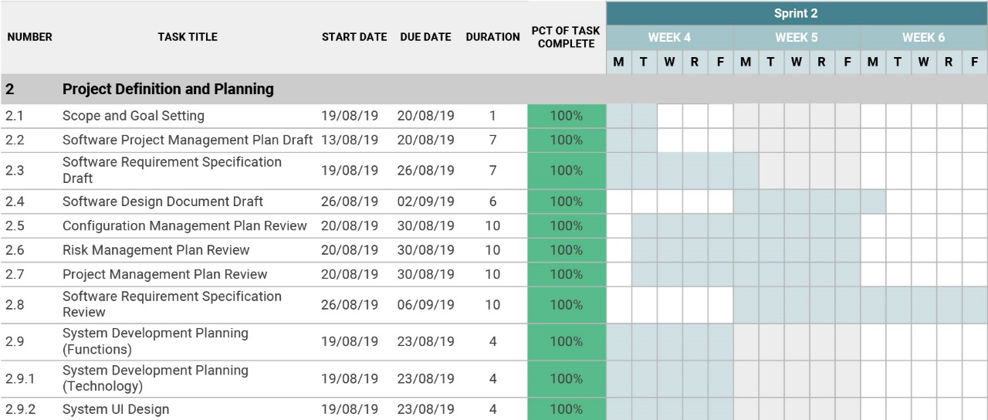
Project Process
The detailed processes of the whole project
Sprint 1
Sprint 2

Slide 12
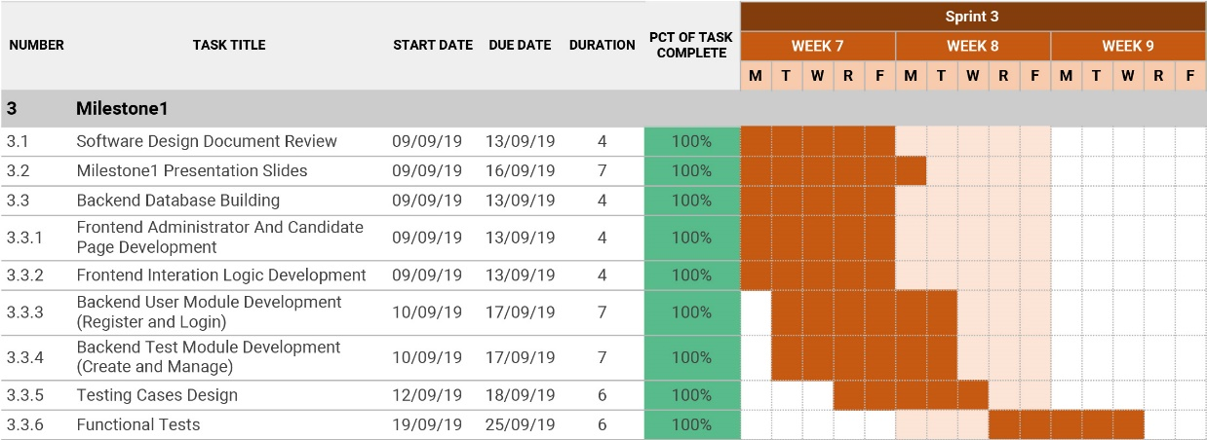
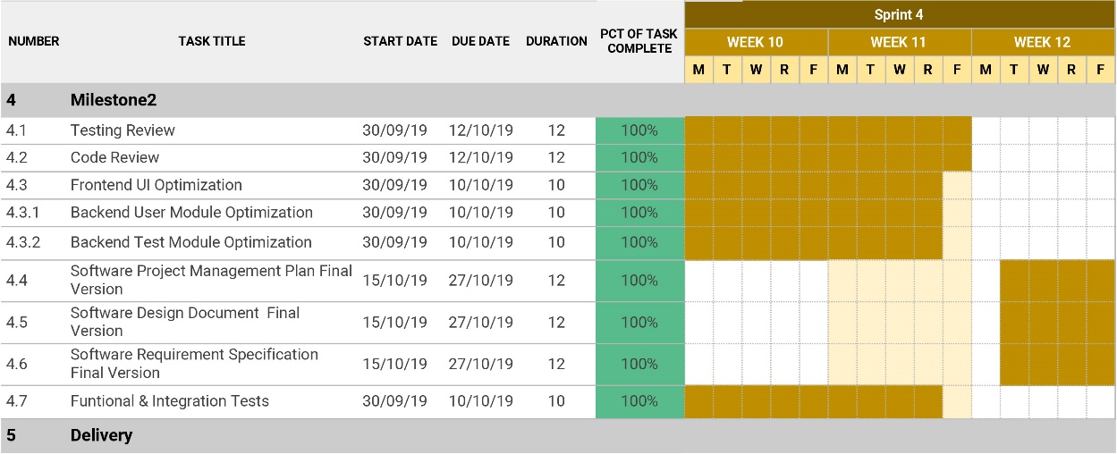
Project Process
The detailed processes of the whole project
Sprint 3
Sprint 4

Slide 13
4
User Journey
The experiences of users on the Hire-me Coder

Slide 14
User Journey
The experiences of users on the Hire-me Coder
Administrator Question management
Candidate Test Participating
User profile
Administrator Test management
Administrator Test sending
Administrator User management
Profile editing
First name and last name/Address cannot be modified
Rest Password
Password confirm/Twice input of new password
Forgot Password
Question preparation
Question describe/File/Picture/Question dialog
Multiple questions
Add questions to test
Update tests content
Delete tests
Test setting
Candidate email
Multiple sending/Email syntax address verification
Question selecting
Expiate date and time
Email preview
Adding new user
Active and deactivate
Users profile edit
Test email
Test link/Candidate account/Candidate password
Test page
Test notification/Due date alert/Answer saving/Answer submitting

Slide 15
5
Achievement
The achievements of milestones

Slide 16
Achievement
The achievements of milestones
Milestone 1 | Status
Login system for administrators | Finish
Manage users in admin mode | Finish
Create questions and tests | Finish
Preview tests | Finish
Milestone 2 | Status
Receive the email | Finish
Update the password | Finish
Attempt the tests and submit the tests | Finish
Save the test and attempt it again later | Finish

Slide 17
6
Conclusion
A conclusion of the project and further improvement

Slide 18
Conclusion
A conclusion of the project and further improvement
This new solution is help to reduce the time for every individual person.
Better utilization for both admin and candidate.
Increase the candidate satisfaction and performance.
Further we can implement video interview option, quick result for interviewee or candidate.

Slide 19
Thank You
Group PG05

